Slide 1
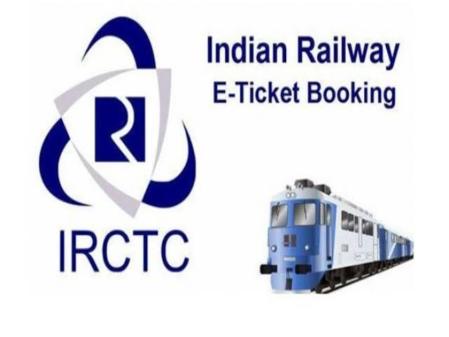
Team Members Anjali Anusha Anusiya Chaitanya Rukmini

Slide 2
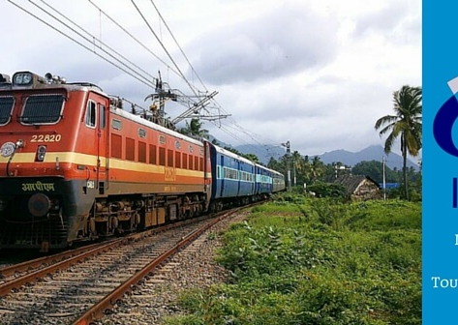
About Project
Our Project title is IRCTC.IRCTC means Indian Railway Catering and Tourism Corporation. It is an Indian public sector undertaking that provides ticketing , catering and tourism services for the Indian Railways.
In that we have tested some modules. That modules are,
1.Verify Sign in functionality
2.Verify Forget Password Functionality
3.Verify the search train functionality.
4.Verify the search flight functionality.
5.Verify the search hotel functionality.

Slide 3

Testers Role
Each member created Epics, User Stories, Test Scenario ,Test Case, and defect report for their respective module and also verified whether all the test cases are working correctly or not.
And also we have checked possible number of test cases.

Slide 4
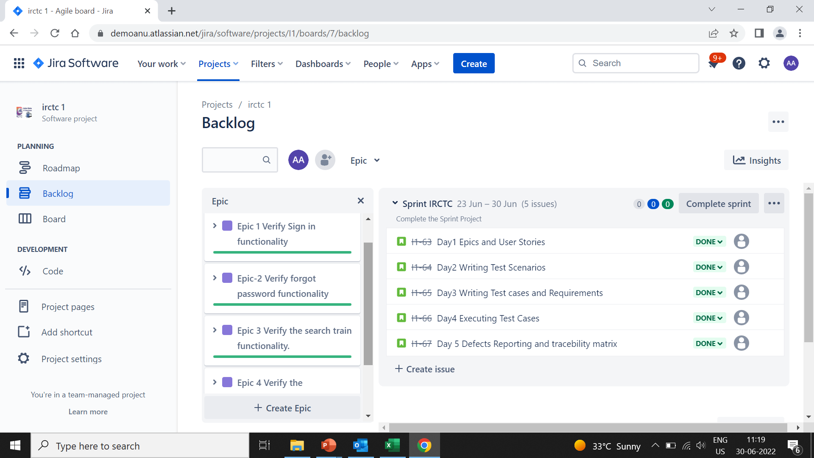
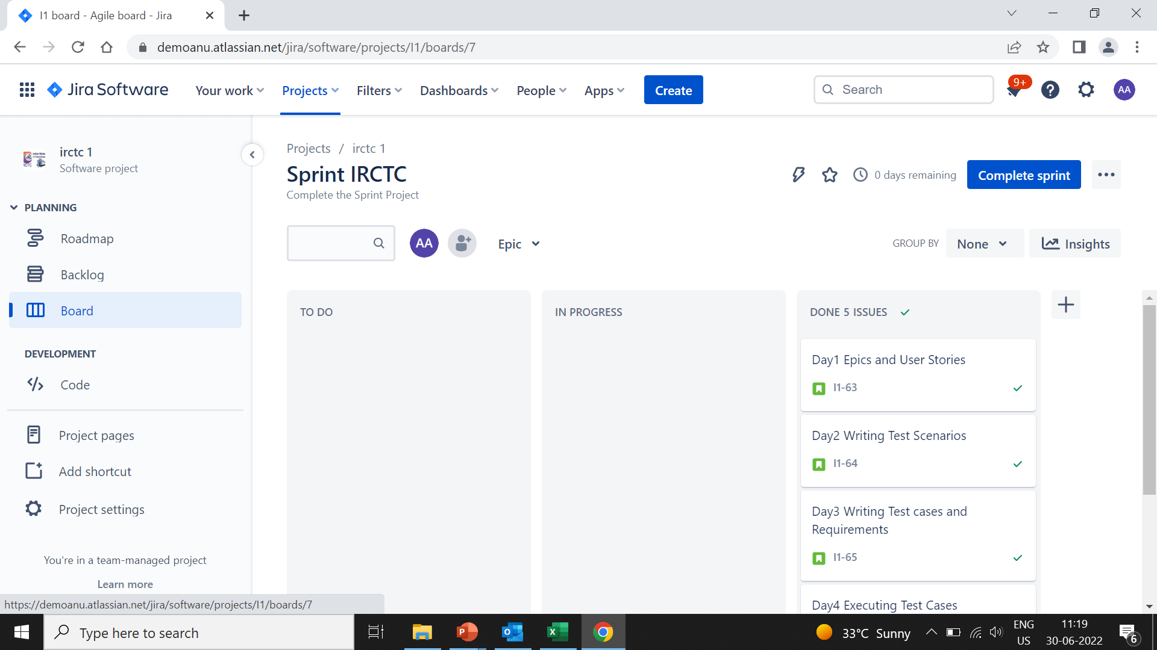
Process of Testing
At first, Epics and user stories are written and then those user stories are added in Jira accordingly.
And then we have started sprint.

Slide 5
High level Epic and User Stories
Epic 1 Verify Signin functionality
Story 1 Verify whether user is able to signin
Story 2 Verify whether user has signin link
Story 3 Verify whether user is able to signin on all versions
Story 4 Verify whether user is able to signin on all versions
Story 5 Verify whether user is able to signin to the application with valid credentials
Story 6 Verify whether user will not be able to signin with invalid credentials
Epic 2 Verify Forget Password Functionality
Story 1 Verify whether user is able to redirect forgot password page when user clicks on forgot password
Story 2 Verify Whether user is able to get the reset password link
Story 3 Verify Whether user is able to access the reset password link
Story 4 Verify Whether user is able to reset password without special character.
Epic 3 Verify the search train functionality.
Story1 Verify Whether user is able to search trains
Story 2 Verify Whether user is able to select trains
Story 3 Verify Whether user is able to view seat availability
Story 4 Verify Whether user is able to book the ticket
Story 5 Verify Whether user is able to select payment option
Story 6 Verify Whether user is able to cancel the ticket
Story 7 Verify Whether user is able to get the the refund
Story 8 Verify Whether user is able to view the review
Story 9 Verify whether user is able to get train details by unrealated data
Epic 4 Verify the search flights functionality.
Story 1 Verify whether user is able to search flights
Story 2 Verify whether user is able to select flights
Story 3 Verify whether user is able to get flight details by unrealated data
Epic 5 Verify the search hotels functionality.
Story 1 Verify whether the user is able to search hotels
Story 2 Verify whether user is able to select hotels
Story 3 Verify whether user is able to get hostel details by unrelated data
An epic is a large body of work that can be broken down into a number of smaller stories, or sometimes called “Issues” in Jira. Epics are almost always delivered over a set of sprints. As a team learns more about an epic through development and customer feedback, user stories will be added and removed as necessary. That’s the key with agile epics: Scope is flexible, based on customer feedback and team cadence.
A user story is the smallest unit of work in an agile framework. It’s an end goal, not a feature, expressed from the software user’s perspective.

Slide 6
Test Scenario
A Test Scenario is defined as any functionality that can be tested. It is also called Test Condition or Test Possibility. As a tester, you should put yourself in the end user’s shoes and figure out the real-world scenarios and use cases of the Application Under Test.
Epic Name | Story Name | TestScenarioID | Requirement ID | Test Scenario Description | Type of Testing | Possible No. of TestCases | Test Case Details
Epic 1 Verify Signin functionality | Story 1 Verify whether user is able to signin | TS_SI_01 | REQ_IRCTC_01 | To verify the user redirects to the signup page | Functional testing | 1 | validate the successful navigation of sign up page
 | Story 2 Verify whether user has signin link | TS_SI_02 |  | To verify the url for IRCTC on Google browser | Functional testing | 1 | validating the URL navigates to IRCTC site
 | Story 3 Verify whether user is able to signin on all versions | TS_SI_03 |  | To verify URL of the website is accessible on all the browser such as Microsoft Edge,Safari,Mozilla Firefox,Chrome | Functional testing | 5 | To verify that the url of the website is functional on all the given browsers
 | Story 4 Verify whether user is able to signin to the application with valid credentials | TS_SI_04 |  | Verify user can login by entering valid credentials | Functional testing | 1 | To verify user can login by entering valid credentials
 | Story 5 Verify whether user will not be able to signin with invalid credentials | TS_SI_05 |  | Verify user cannot login by entering invalid credentials | Functional testing | 4 | To verify user cannot login by entering invalid credentials
Epic 2 Verify Forget Password Functionality | Story 1 Verify whether user is able to redirect forgot password page when user clicks on forgot password | TS_LI_06 | REQ_IRCTC_02 | To Verify whether user is able to redirect forgot password page | Functional testing | 1 | Verify the user is able to redirect fotgot password page
 | Story 2 Verify Whether user is able to get the reset password link | TS_LI_07 |  | Verify the user reset by using the forgotten password link | Functional testing | 1 | To verify the user can reset password by using the forgot password link
 | Story 3 Verify Whether user is able to access the reset password link | TS_LI_08 |  | Verify user's password reset link has access to resetting the password | Functional testing | 1 | To verify user's password reset link has access to resetting the password
 | Story 4 Verify Whether user is able to reset password without special character. | TS_LI_09 |  | Verify user gets an error message when they make the new password without special characters | Functional testing | 8 | To verify the user gets an error message when he try to make the new password without special characters
Epic 3 Verify the search train functionality. | Story1 Verify Whether user is able to search trains | TS_SR_10 | REQ_IRCTC_03 | To verify whether the user is able to search Train | Functional testing | 10 | To verify the user can access the search option
 | Story 2 Verify Whether user is able to select trains | TS_SR_11 |  | To verify whether the user is able to select Train | Functional testing | 10 | To verify whether the user can access to select Train
 | Story 3 Verify Whether user is able to view seat availability | TS_SR_12 |  | To verify Whether user is able to view seat availability | Functional testing | 5 | To verify the user is able view the seat availability
 | Story 4 Verify Whether user is able to book the ticket | TS_SR_13 |  | To verify Whether user is able to book the ticket | Functional testing | 3 | To verify user is able to book the ticket
 | Story 5 Verify Whether user is able to select payment option | TS_SR_14 |  | To verify Whether user is able to select payment option | Functional testing | 5 | To verify the user should be able to select payment option
 | Story 6 Verify Whether user is able to cancel the ticket | TS_SR_15 |  | To verify Whether user is able to cancel the ticket | Functional testing | 5 | To verify the user is able to cancel the ticket
 | Story 7 Verify Whether user is able to get the the refund | TS_SR_16 |  | To verify Whether user is able to get the the refund | Functional testing | 3 | To verify the user is able the get the refund
 | Story 8 Verify Whether user is able to view the review | TS_SR_17 |  | To verify Whether user is able to view the review | Functional testing | 3 | To verify the user is able to view the review
 | Story 9 Verify whether user is able to get train details by unrealated data | TS_SR_18 |  | To validate user is getting the details of the train | Functional testing | 3 | To verify user gets an error message when the user try to get Train details by unrelated data
Epic 4 Verify the search flights functionality. | Story 1 Verify whether user is able to search flights | TS_SR_19 | REQ_IRCTC_04 | To verify whether the user is able to search Flights | Functional testing | 10 | To verify the user can access the search option
 | Story 2 Verify whether user is able to select flights | TS_SR_20 |  | To verify whether the user is able to select Flight | Functional testing | 10 | To verify whether the user can access to select Flight
 | Story 3 Verify whether user is able to get flight details by unrealated data | TS_SR_21 |  | Verify user gets an error message when the user is able to get Flight details by unrelated data | Functional testing | 3 | To verify user gets an error message when the user try to get Flight details by unrelated data
Epic 5 Verify the search hotels functionality. | Story 1 Verify whether the user is able to search hotels | TS_SR_22 | REQ_IRCTC_05 | To verify whether the user is able to search Hotels | Functional testing | 10 | To verify the user can access the search option
 | Story 2 Verify whether user is able to select hotels | TS_SR_23 |  | To verify whether the user is able to select Hotels | Functional testing | 10 | To verify whether the user can access to select Hotel
 | Story 3 Verify whether user is able to get hostel details by unrelated data | TS_SR_24 |  | Verify user gets an error message when the user is able to get Hotels details by unrelated data | Functional testing | 3 | To verify user gets an error message when the user try to get Hotel details by unrelated data

Slide 7
Requirements
1. User should be able to Sign in
For sign in user needs user name, password, mobile number
2. User should be able to reset the password
for reset link user needs registered mail id
User should match the password criteria
3. User should be able to Search Train
User should be able to view train as well as train details
User gets an error message when the user is able to get Train details by unrelated data
4. User should be able to Search Flight
User should be able to view train as well as Flight details
User gets an error message when the user is able to get Flight details by unrelated data
5. User should be able to Search Hotel
User should be able to view train as well as Hotel details
User gets an error message when the user is able to get Hotel details by unrelated data

Slide 8
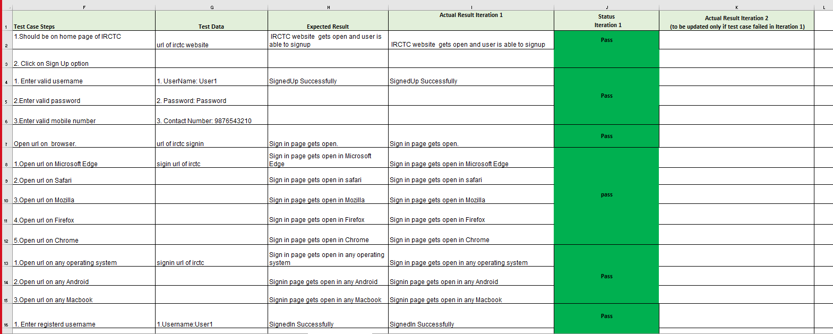
Test cases
A test case is a document, which has a set of test data, preconditions, expected results and postconditions, developed for a particular test scenario in order to verify compliance against a specific requirement.

Slide 9
Defect report
As IRCTC is live application there will be no defects in this but we intentionally made a defect repot by making some test cases fail.
1. signin
To verify the credentials user entered in the login page is valid or invalid
User is getting signed in inspite of invalid credentials
2. forget password
To verify whether the user able to create a new password with specail character or not
new password should be created
3.Getting unrelated trains data
To verify the details of the train selected is valid or not
User is getting the details of the train by unrelated data
4.Getting unrelated flights data
To verify the details of selected flight
Details of selected flight is correct or not
5.Getting unrelated hotels data
To verify the details of selected hotel
Details of selected hotel is correct or not

Slide 10
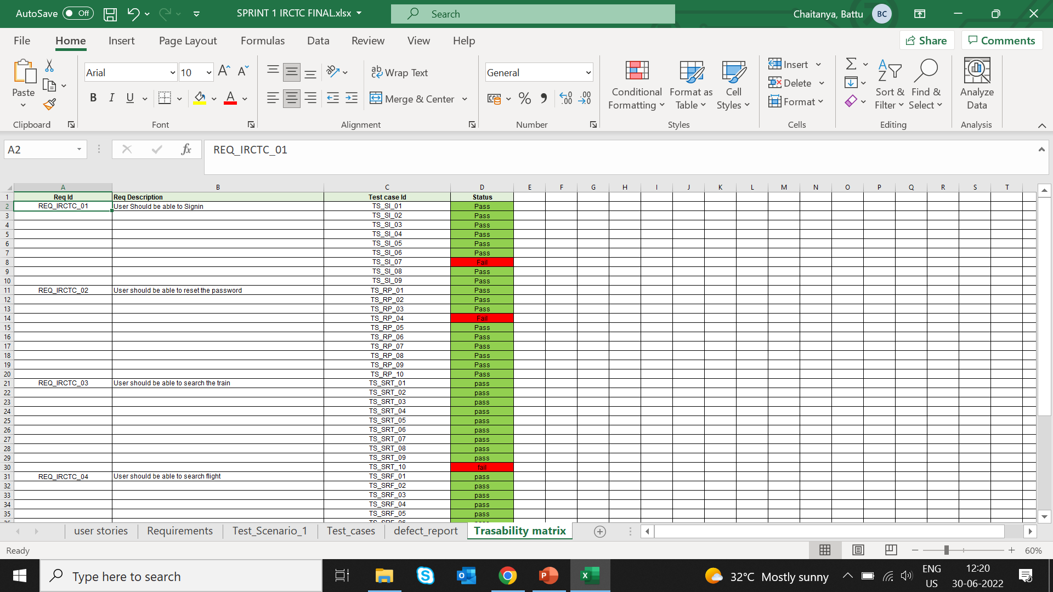
Traceability matric
Definition: A traceability matrix is a document that details the technical requirements for a given test scenario and its current state.

Slide 11
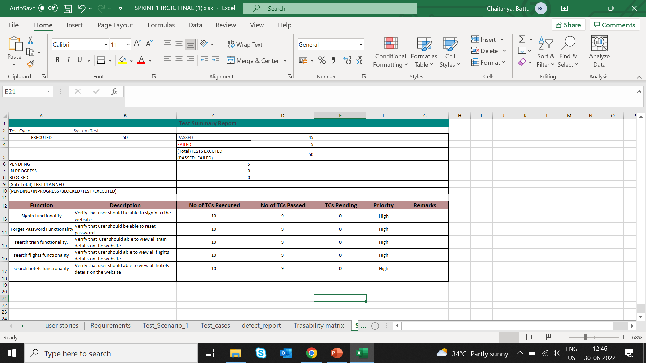
Summary report
A test summary report is a Quality work product / Test Document that formally summarizes the results of all testing.

Slide 12
Challenges faced
As we are new to the Agile and Jira applications firstly we are not familiar with the environment
And we didn’t understood how to add epic’s, user stories
Also we didn’t know how to start sprint and creating bugs
Latter we rectified that problem and completed the project.

Slide 13

Thank you!! For your Attention

